Slide 1

Introduction to Genome Sequencing
Dr Liz Batty

Slide 2
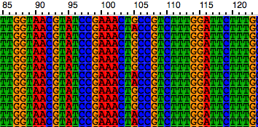
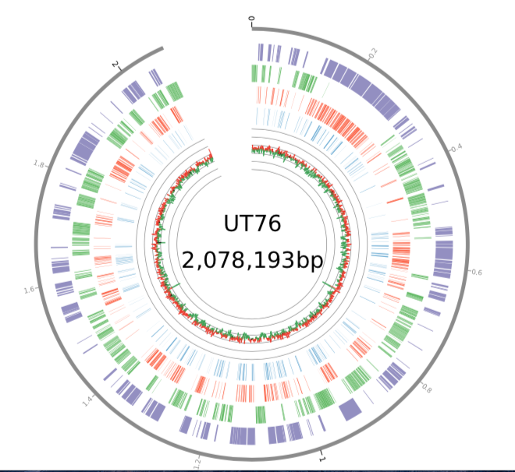
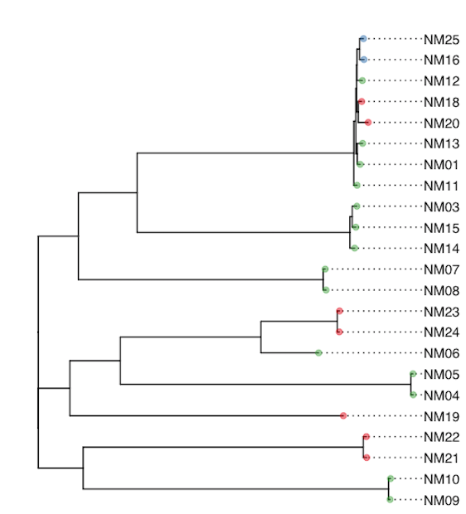
How do we sequence bacterial genomes?
@SEQ_ID
GATTTGGGGTTCAAAGCAGTATCGATCAA
+
!''*((((***+))%%%++)(%%%%).1*

Slide 3
Technology | Machine | Read length | Output from one run | Error Rate
Illumina | HiSeq | 75-150bp | 250-300Gb | <1%
 | MiSeq | 75-300bp | 15Gb
Ion Torrent |  | 200-400bp | 2Gb | ~1%
PacBio |  | Tens of kb | Up to 10Gb | ~15%
Oxford Nanopore |  | Tens of kb, up to 1Mb | ~15Gb | ~15%

Slide 4
Illumina and Ion Torrent
Cut DNA into short fragments
Amplify
Add bases and detect incorporation

Slide 5
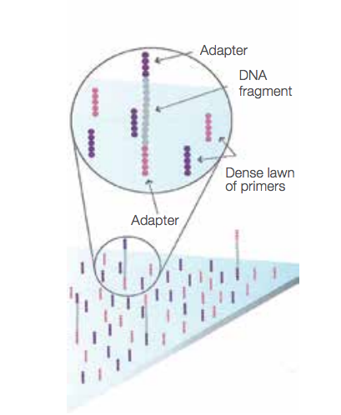
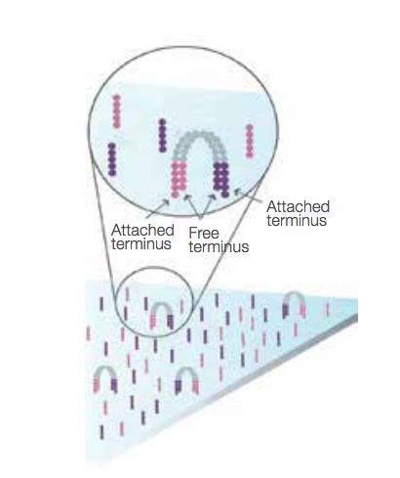
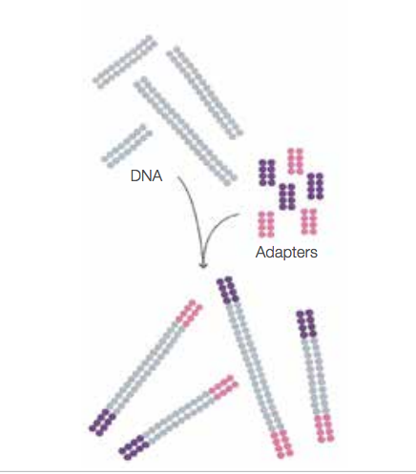
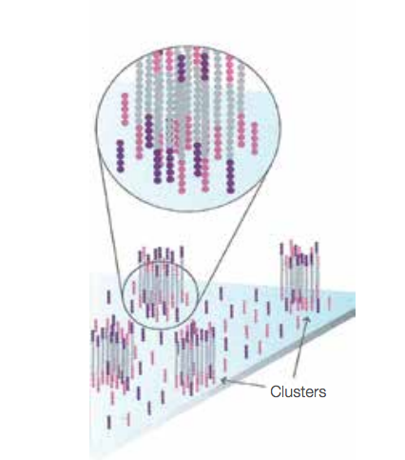
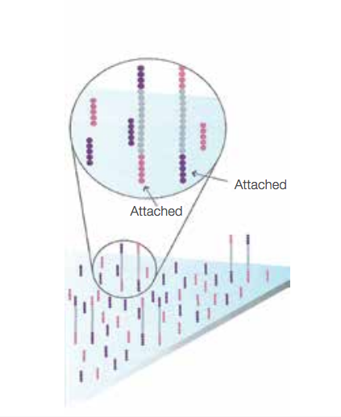
Illumina sequencing - amplification
1.
2.
3.
4.
5.
Notes:
Fragment the DNA into 200-500bp fragments and add adapters
Fragments are fixed to a solid flowcell with lawn of primers
Fragment bends over and the second stand is synthesized,
then denatured and separated
Repeat until a cluster of millions of sequences is formed
Millions of these clusters are formed on each flowcell and each one will represent a single read
Used to be performed on a second machine, is now performed in situ on the same machine that sequences

Slide 6
Illumina sequencing – detection
Notes:
Four nucleotides with four different fluorescent dyes all added at once
Wash step and the slide is imaged
The dye and the chain termination groups are cleaved from each sequence and another round begins
Images are basecalled using image-processing software
Length of read is limited by the number of cycles you can run, which is improved by better chemistry and faster image detection

Slide 7
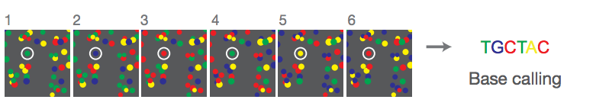
Illumina sequencing - detection
Notes:
Newer Illumina systems (NextSeq) use 2-channel detection which is faster and has similar accuracy

Slide 8
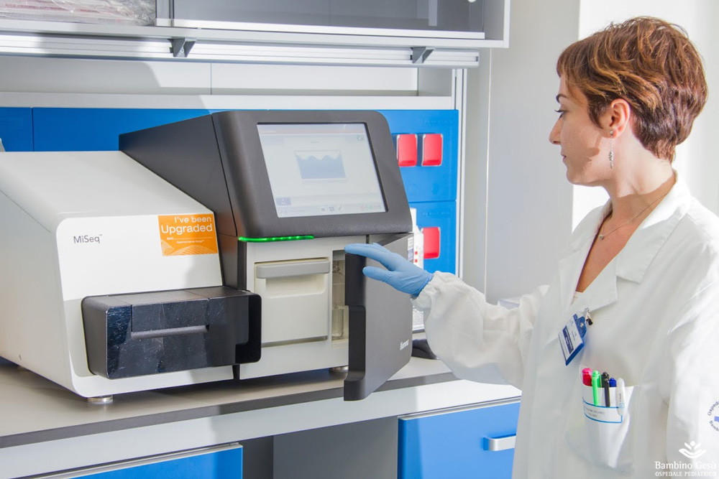
https://www.flickr.com/photos/97397973@N05/19092162353/

Slide 9
Ion Torrent Sequencing – amplification
Notes:
Emulsion PCR – reaction happens in oil droplets which each contain a bead and PCR reagents and a single DNA molecule. Similar purpose to Illumina – get a lot of identical sequences in one place so that you can detect the emissions

Slide 10
Ion Torrent Sequencing – detection
Notes:
A – each bead covered in template is placed into a single well of an Ion chip, a specialised semiconductor chip, measures the release of hydrogen ions when a nucleotide is incorporated

Slide 11
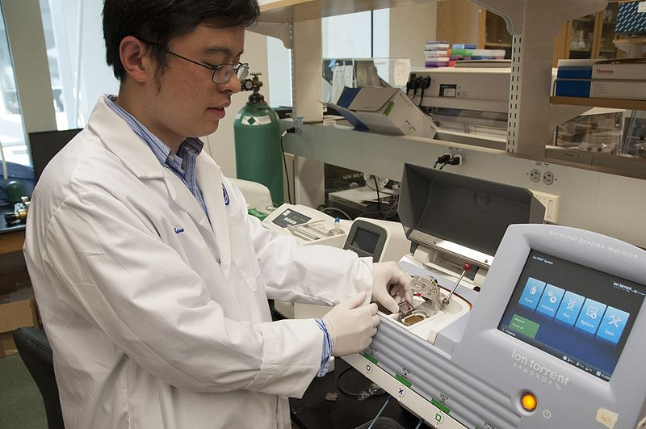
https://www.flickr.com/photos/fdaphotos/8754348757/

Slide 12
PacBio and Nanopore - single molecule sequencing
No amplification needed
Reduces GC bias
Allows for longer reads
Currently higher error rates
Notes:
Longer reads as no amplification step is needed

Slide 13
Pacific Biosciences (PacBio)
Notes:
Single molecule real-time sequencing. Polymerase is bound to a zero-module waveguide – a tiny nanostructure which allows for observations at the surface of the polymerase to occur. No termination is necessary, sequences are read in real time.

Slide 14
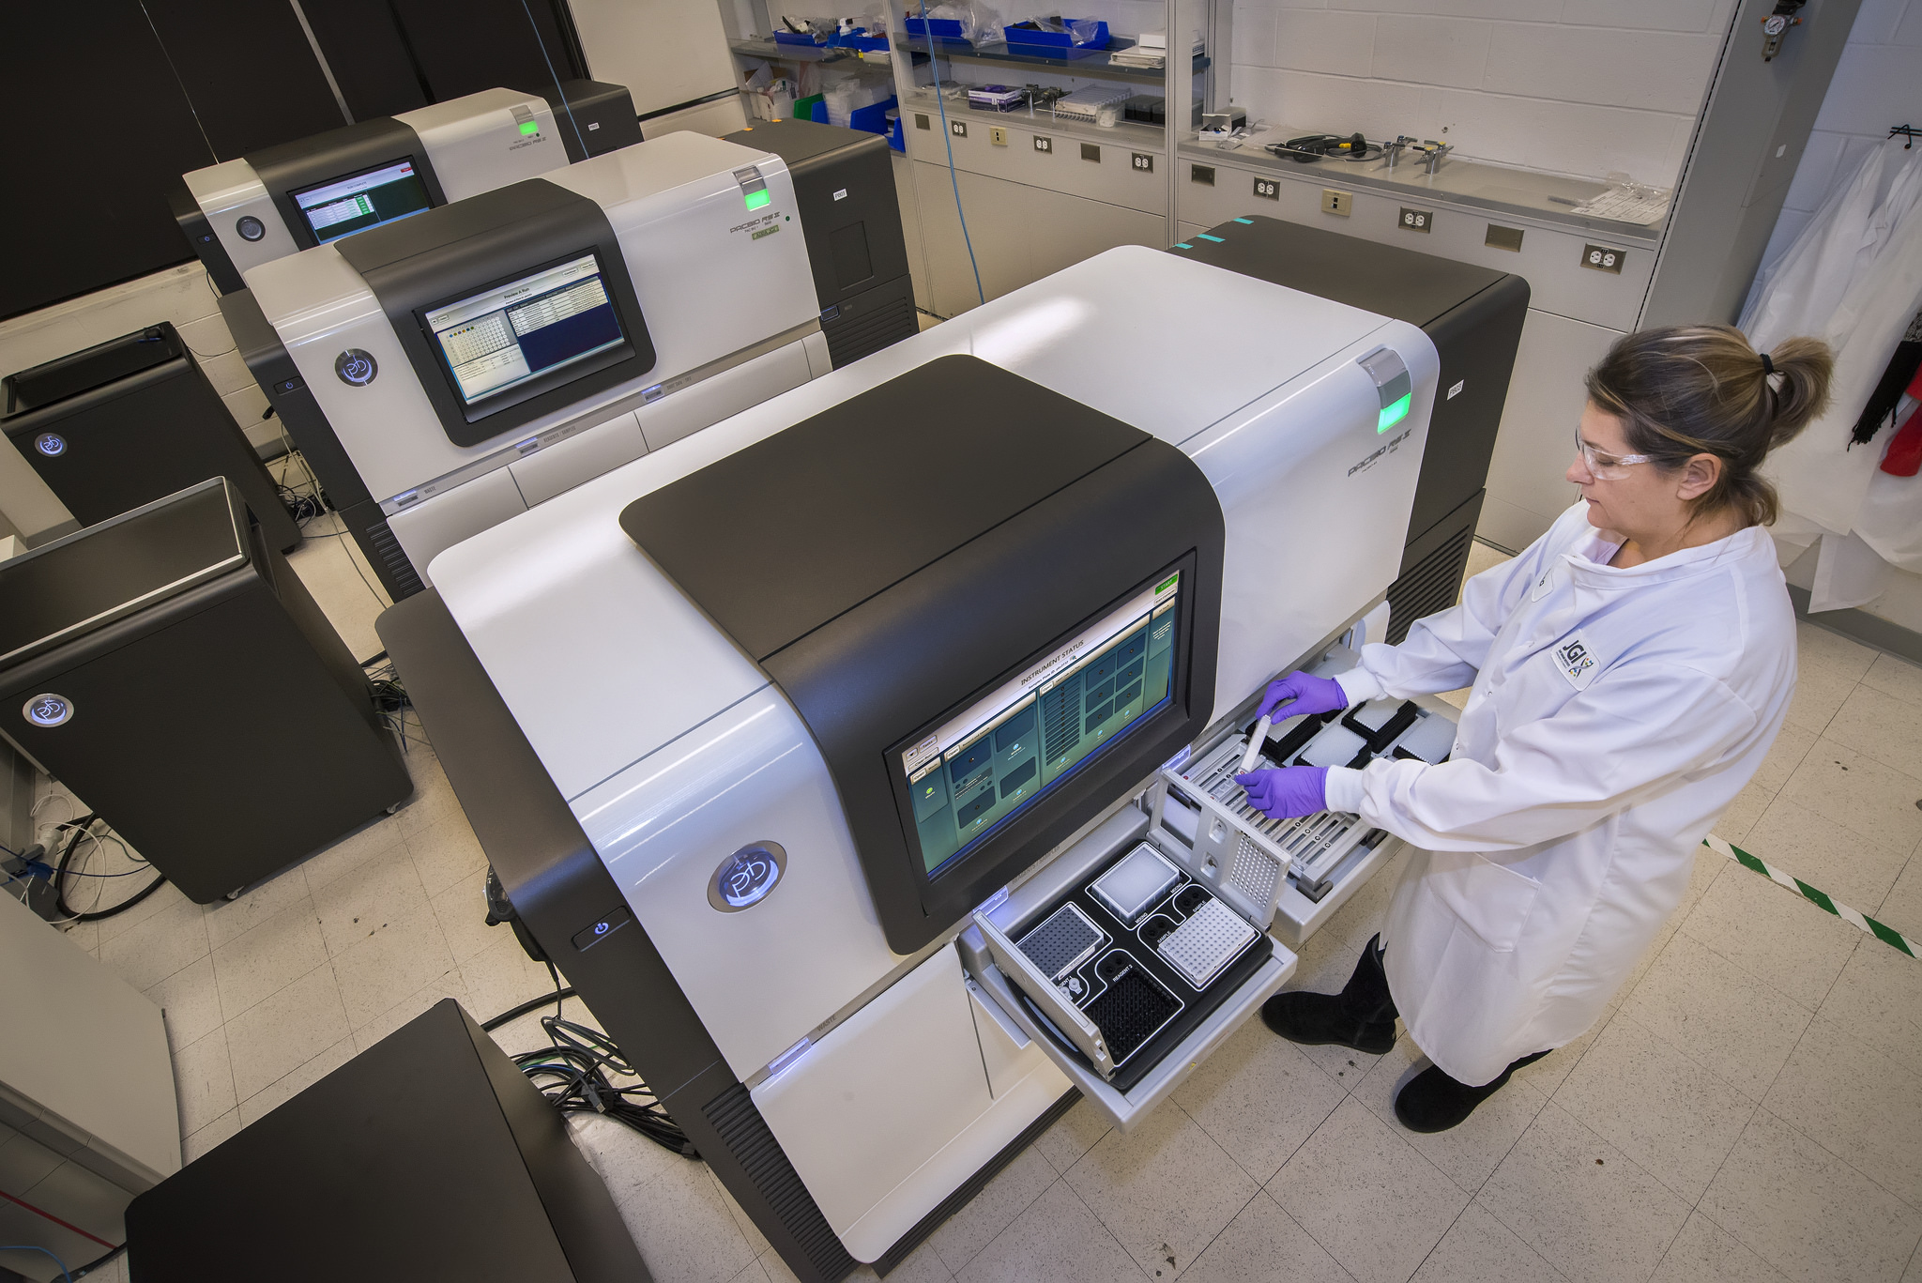
https://www.flickr.com/photos/doe_jgi/34810045553/

Slide 15
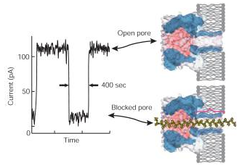
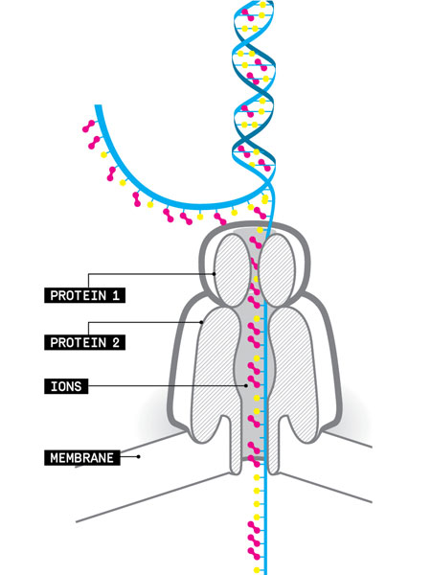
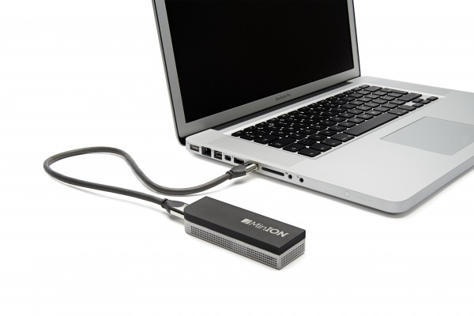
Nanopore Sequencing
Notes:
Uses modified cellular membrane proteins which are designed to translocate DNA. Mount hundreds in a membrane connected to sensors that measure the current. When DNA is passing through the curreent will change and can be measured, and different bases cause different changes in current. MinION is current prototype machine – tiny, runs at room temperature off a USB port.

Slide 16
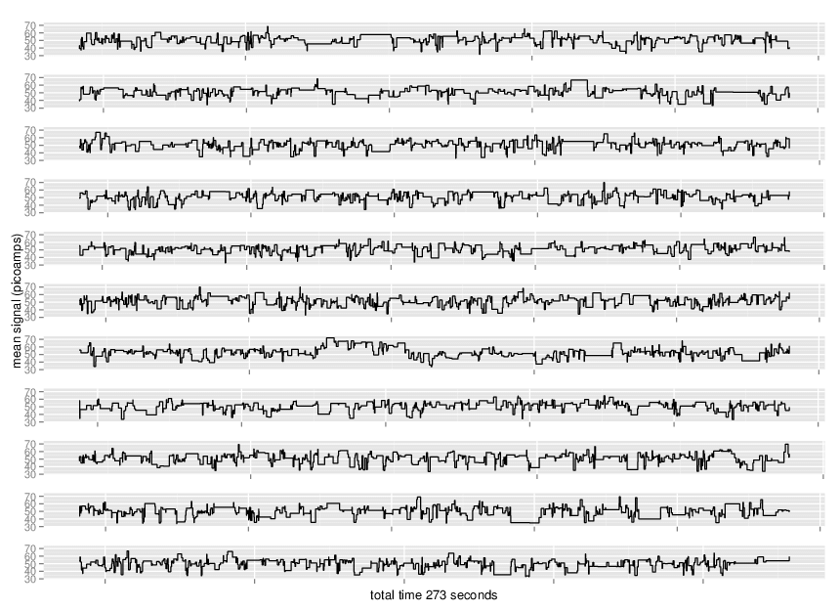
Nanopore Sequencing - detection
Notes:
Raw data is a ‘wiggle plot’ – no images, this is a measure of the current through a pore as the DNA passes through. This signal is turned into a DNA sequence.

